Slide 1
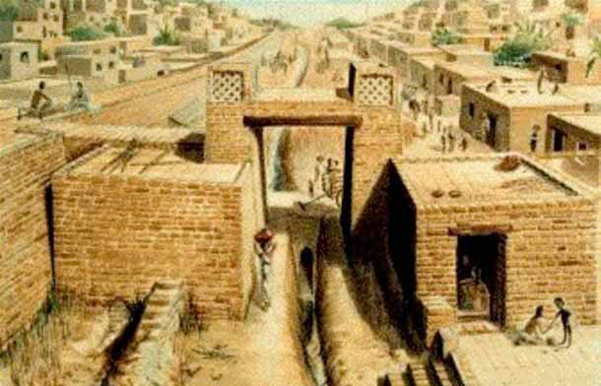
Science and Technology in India
Dr. Driggers
HIST 1310
STUDENT VIEW

Slide 2
Agenda
Survey of science, technology, and medicine throughout early Indian history
Our last non-western civilization before we turn to Western Europe
Remember to compare and contrast the civilization
A list of chapters for the exam will be posted this weekend (but you can consult the syllabus)

Slide 3
Key Quotations to Get Us Started
From the Aryabhata [The most influential work of early Indian mathematical astronomy, written around 6th Century CE]
“Whoever knows…the movements of the Earth and the planets in the sphere of the asterisms, [travels] through the paths of the planets and constellations and goes to the higher Brahman [God].”
“He who disparages this universally true science of astronomy…loses his good deeds and his long life.”

Slide 4
Perhaps Echoes in Religion and Science
From the writings of Isaac Newton, “This most beautiful system of the Sun, planets, and comets could only proceed from the counsel and domination of an intelligent and all-powerful Being.”
From the Rg Veda: “O Shakers of the earth, moved by whose wisdom, whose design?...When what is strong ye overthrow, and whirl about each ponderous thing…Your course is through the forest trees of earth, and through the fissures of the rocks…Even the earth herself listened as ye came near, and men were sorely terrified.”

Slide 5
From the Writings of J. Robert Oppenheimer
One of the participants of the Manhattan Project; also comes out against project
Quoted the Bhagwat-Gita after the 1945 Atomic Bomb Detonation over Hiroshima
“I am become death, destroyer of worlds…”
From the text: “The Blessed Lord said: Time I am, destroyer of the worlds, and I have come to engage all people. With the exception of you [the Pāṇḍavas], all the soldiers here on both sides will be slain.”

Slide 6
Blending of Traditions
Indian Science is often characterized by the blending of many different traditions
Just look at its location on the map!
Location, Location, Location

Slide 7
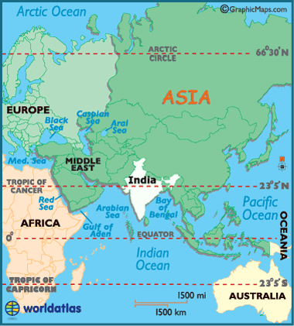
General Map

Slide 8
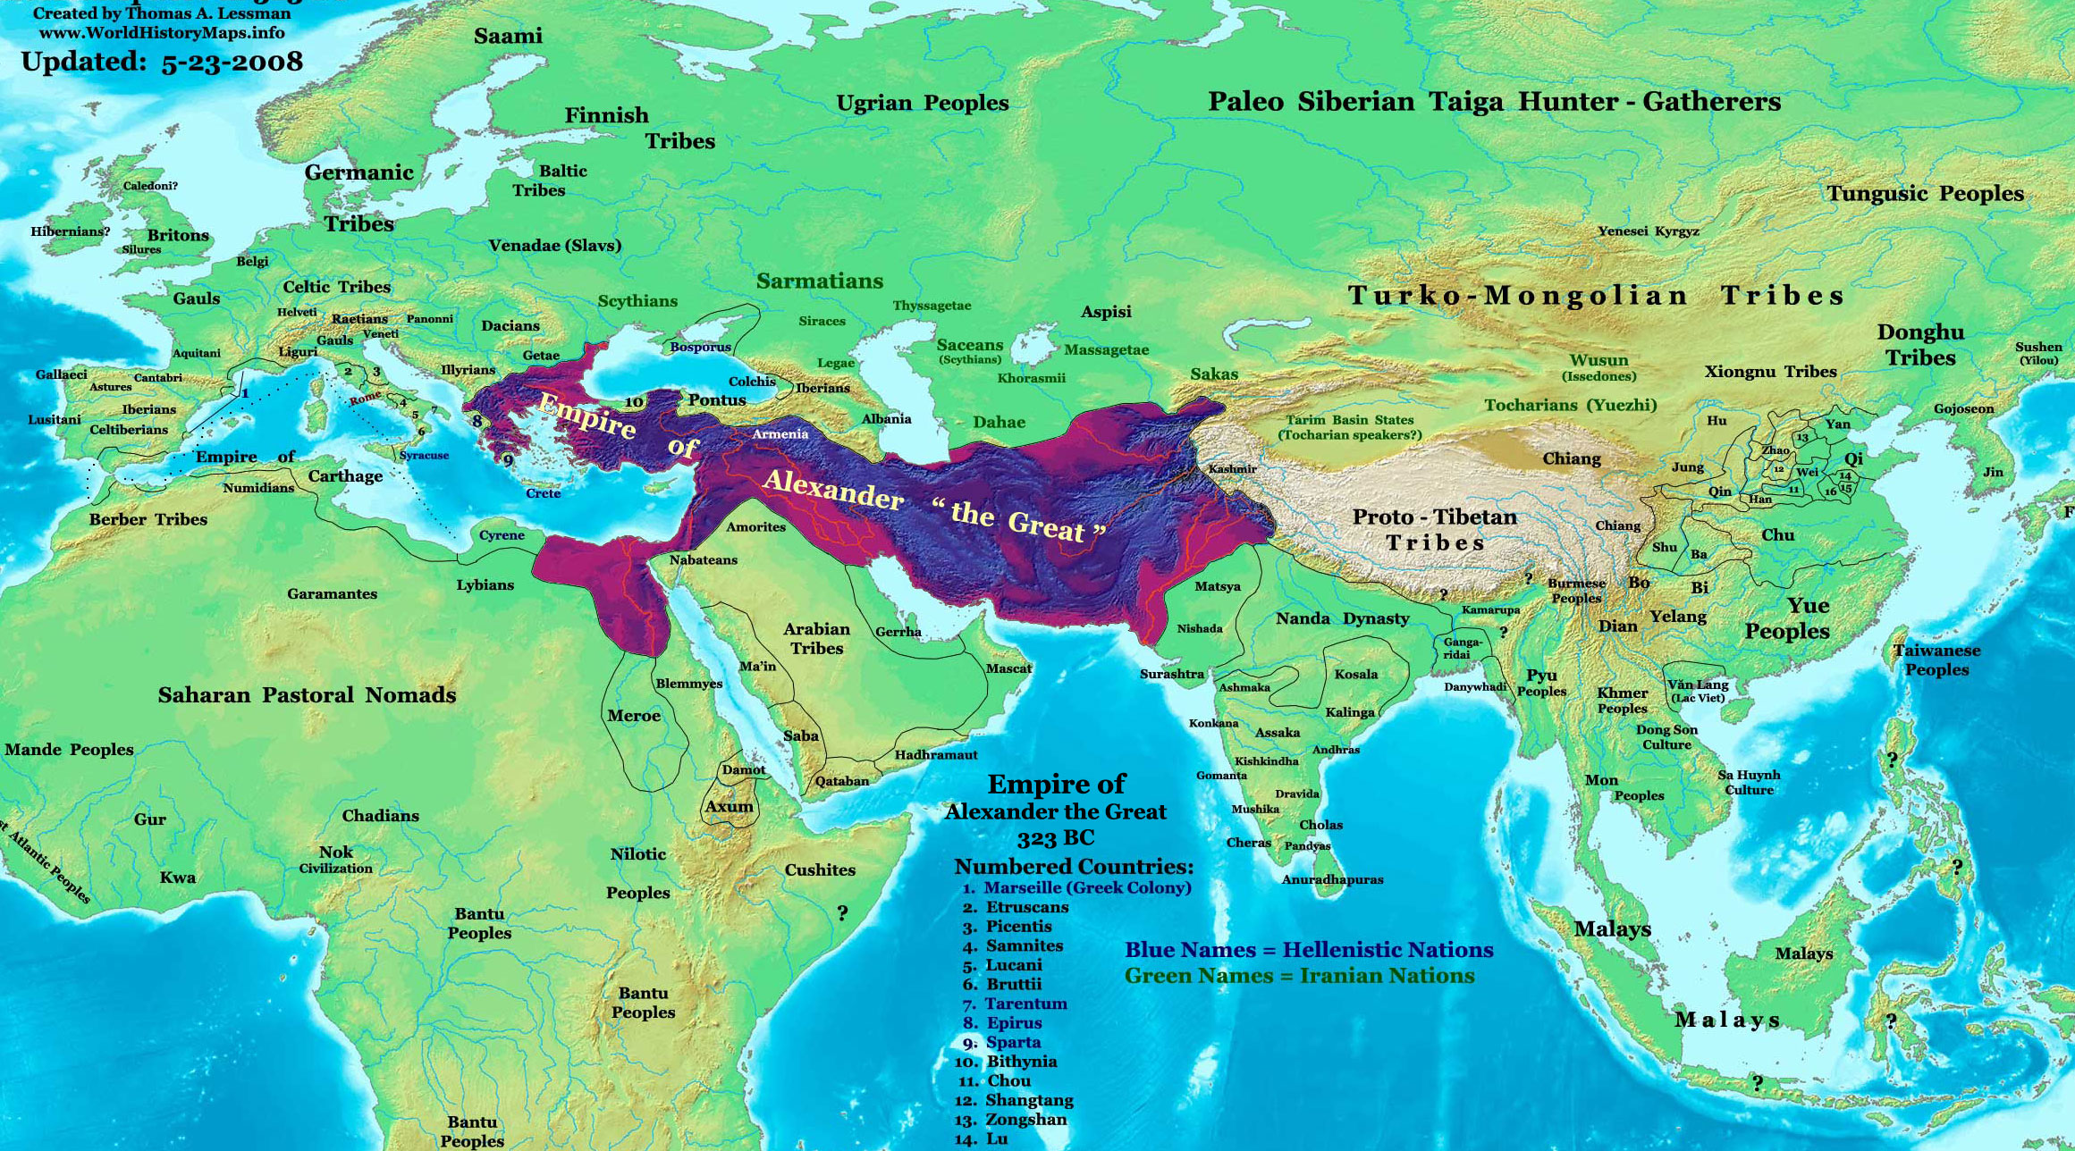
The World in the Time of Alexander the Great

Slide 9
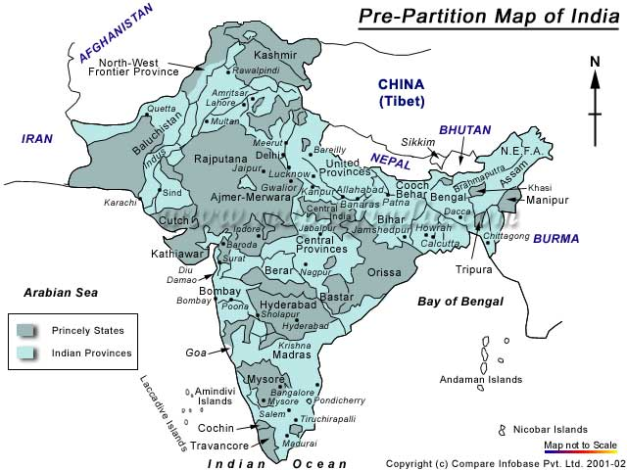
India Goes through a lot of Changes

Slide 10
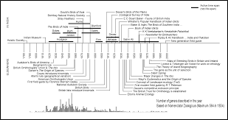
Timeline of Indian History (Very Long & Good Reference)

Slide 11
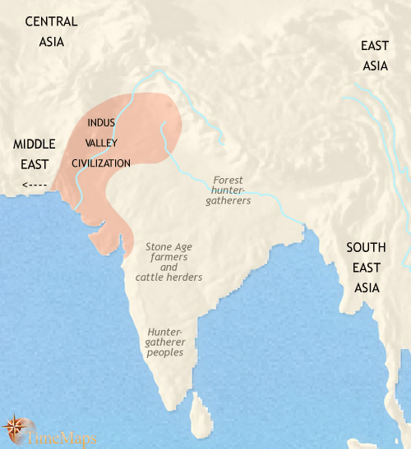
Background of the Indus Valley Civilization

Slide 12
Introduction to Early Indian History
General Remarks about the Indus Valley Civilization
Agriculture and Language; General Remarks on Organization
Transition to Science and Technology

Slide 13
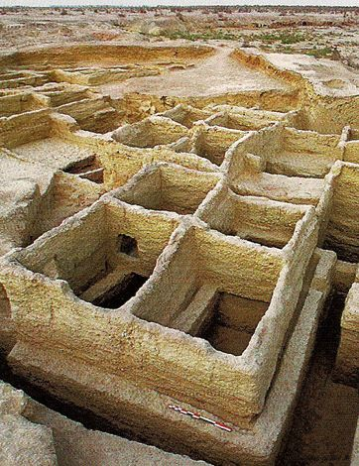
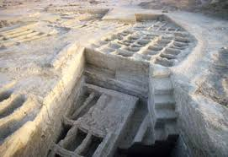
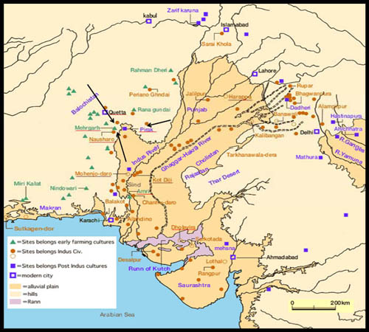
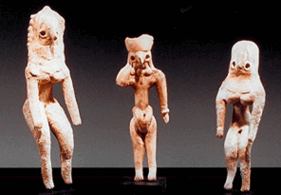
Mehrgarh

Slide 14
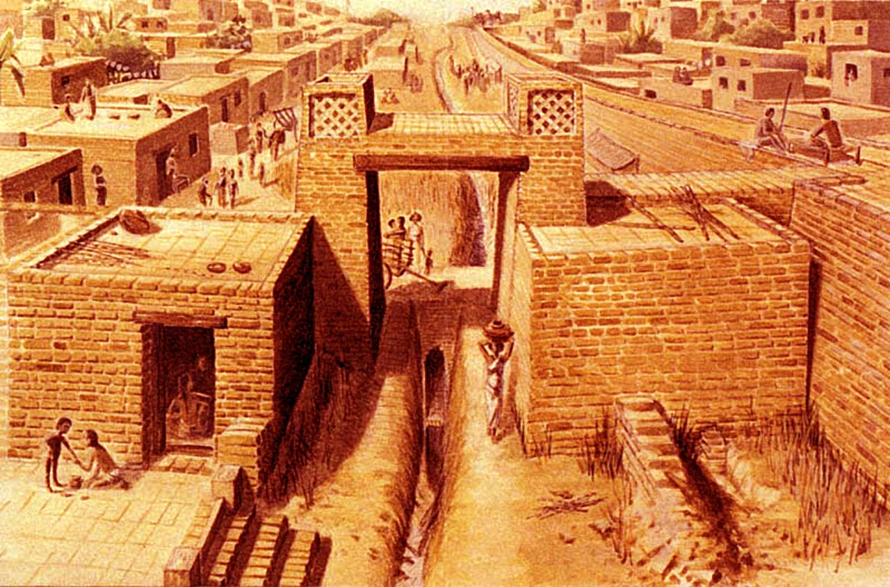
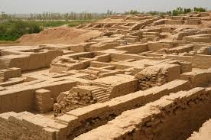
City of Harappa

Slide 15
New Crops and Urbanization
Nearly All major trade routs were established before 3000 BCE
Trading from Afghanistan—Persian Gulf, in places like present day Bahrain and the UAE
New settlements: more larger urban centers! High emphasis on Urban Planning
New crops: sesame, peas, dates, cotton
Experimentation with native and non-native vegetation
Rainfall and floodplain regeneration were abundant enough not to drive irrigation and reservoirs
Perhaps a society not solely based on agriculture, but on manufacturing and technology???

Slide 16
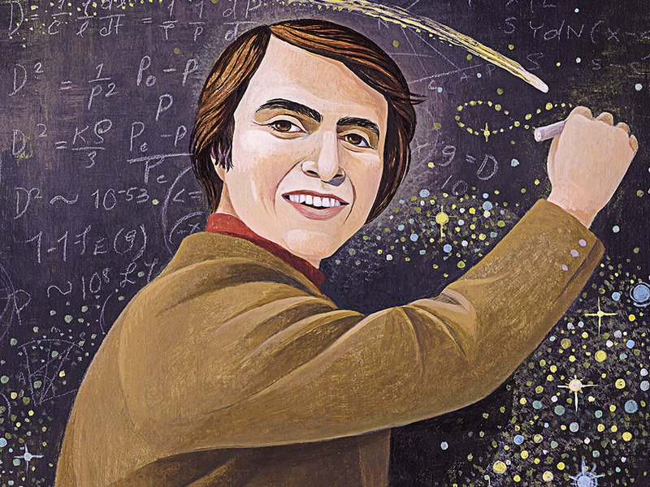
Vedic Culture
“Vedic Cosmology is the only one in which the time scales correspond to those of modern scientific cosmology.”

Slide 17
Vedic Culture and Science
Later changes
One major difference between early Indus Valley settlements and after the Vedas:
Saw the creation of empires
Building Fortress
Realities of Widespread conflict

Slide 18
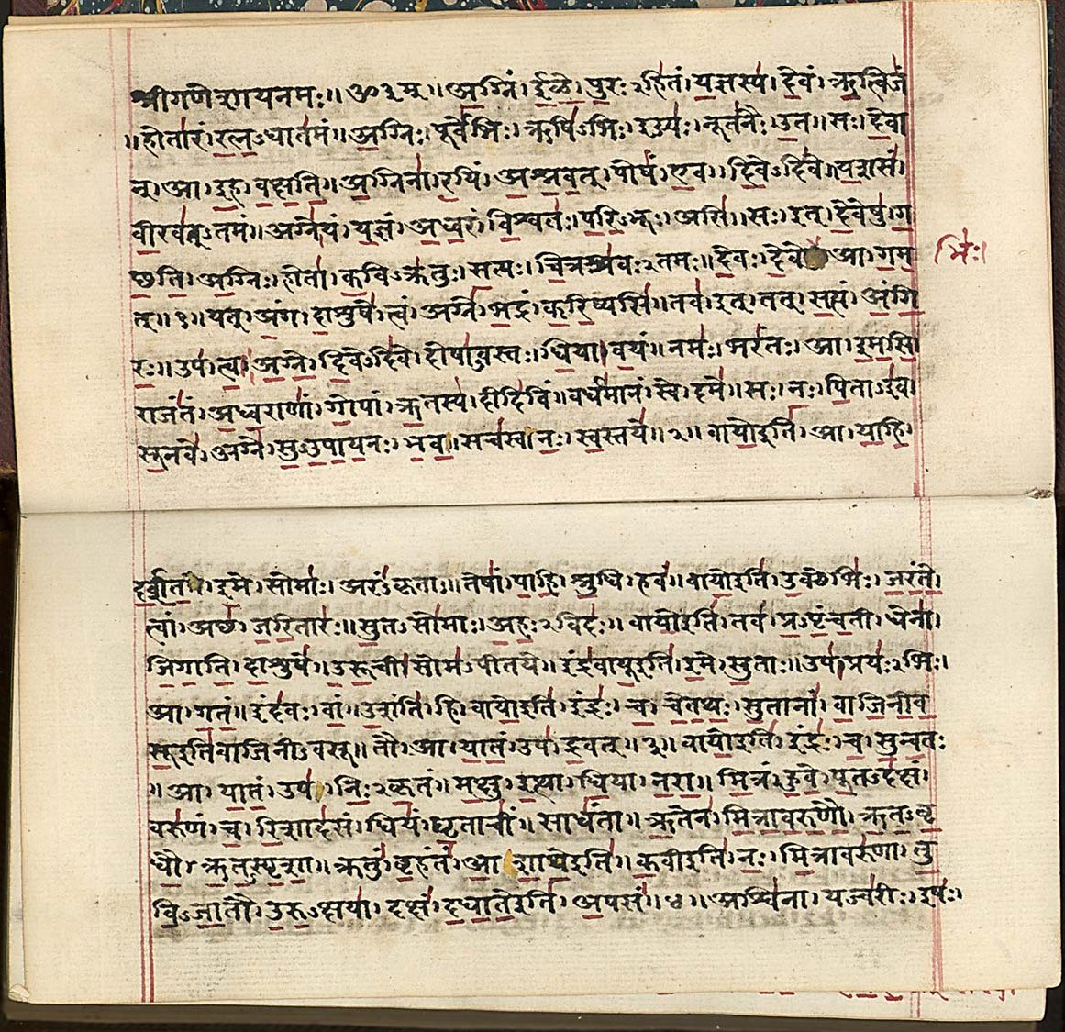
The Vedas and the Upanishads
Discussion of Vedas
Four Parts
The Rg (hymns for priests)
Yajur (rites of sacrifice)
Sama (chants sung to music)
Atharva (spells, metaphysical songs)

Slide 19
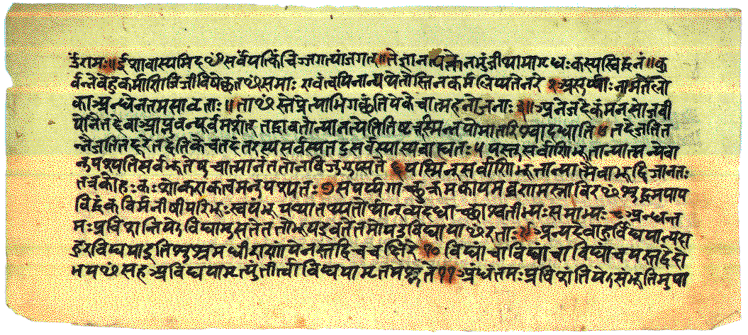
Discussion of the Upanishads (Sittings of the Teacher)
Upanishads (Philosophical Commentaries that introduced the idea of karma, reincarnation, and yoga)

Slide 20
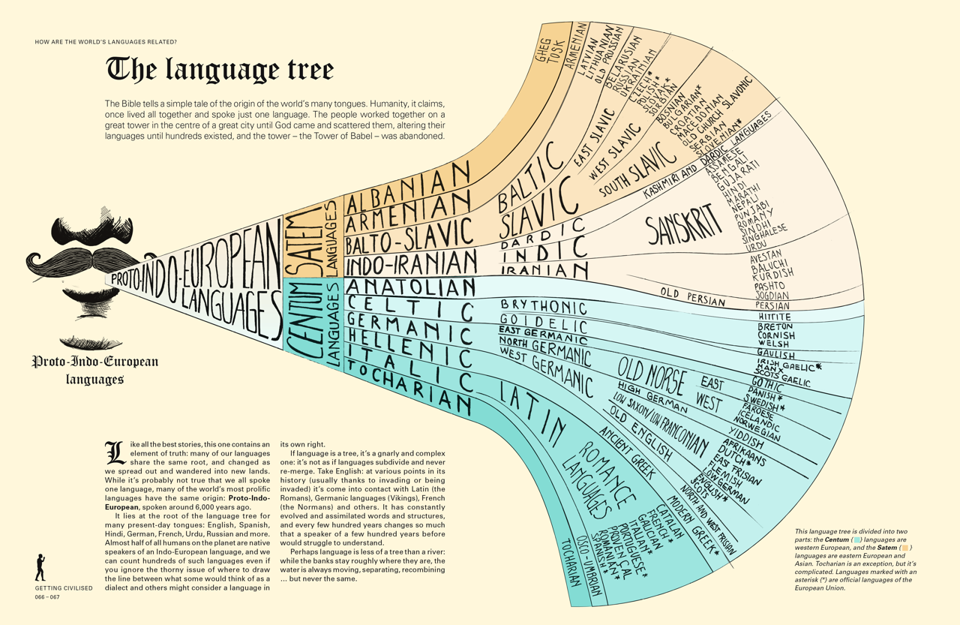
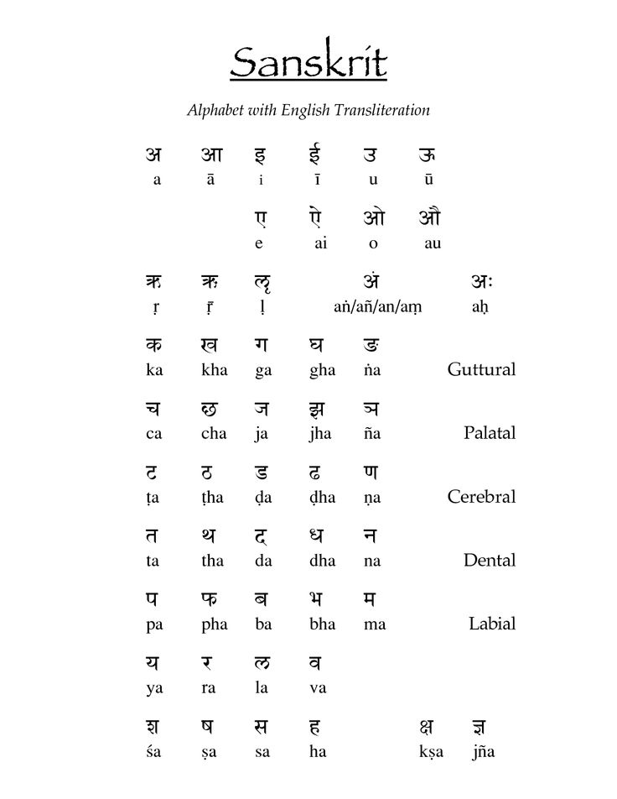
Sanskrit

Slide 21
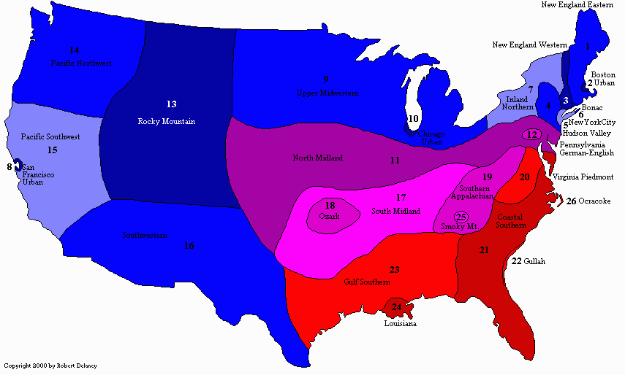
Linguistics is SO interesting!

Slide 22
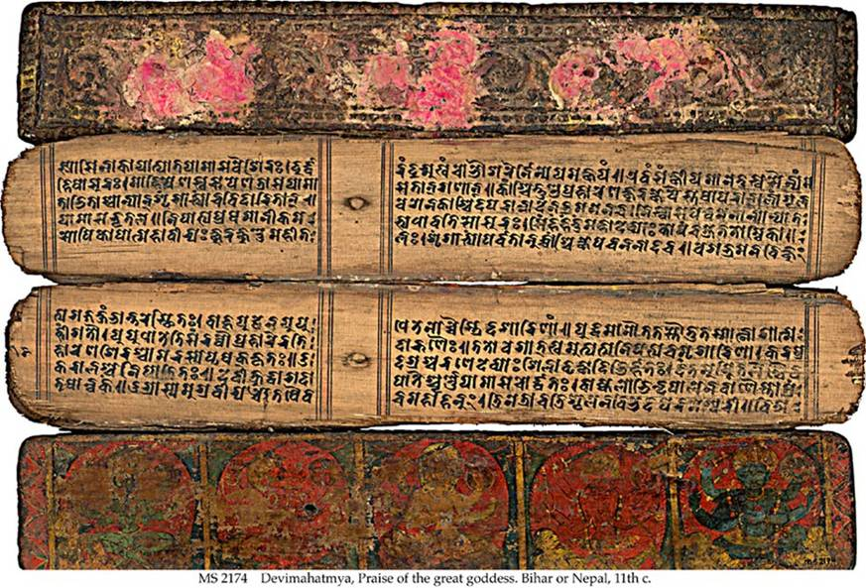
Puranas
They treat the whole Vedic Cosmology (creation cycles, history of gods, story of humankind) and Hindu Mythology up to about 1000 CE
There are other texts that are about more specific subjects that might be re-writings of subjects discussed in the Vedas

Slide 23
The Vedas: They Tell us Many Things about Science and Natural Ideas
Mostly a pastoral, even semi-nomadic people
Not like Harappan Culture
Became stratified society over time: according to birth and ruled by a dynastic monarchy
Courts patronized artistic and scientific expression
Different classes emerged

Slide 24
Stratified Society
Parts of a cultural body:
Brahmanas/Brahmin: Scholarly/priestly class, presented the mouth according to Vedic culture
Kshatriyas (aka Rajanyas), Ruling/warrior class, were the arms
Vaishyas: Business and Merchant Class—perhaps the largest part of society, and the stomach [or thighs]
Shudras: laboring class, constituted the feed on which society stood

Slide 25
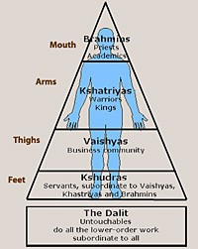
Cosmology

Slide 26
Vedas and Astronomy
General Remarks about Astronomy—the Why
Vedas and Astronomy
Unity at every level
Scholars argue that Vedas are based on astrological knowledge?
Rituals and astrology

Slide 27
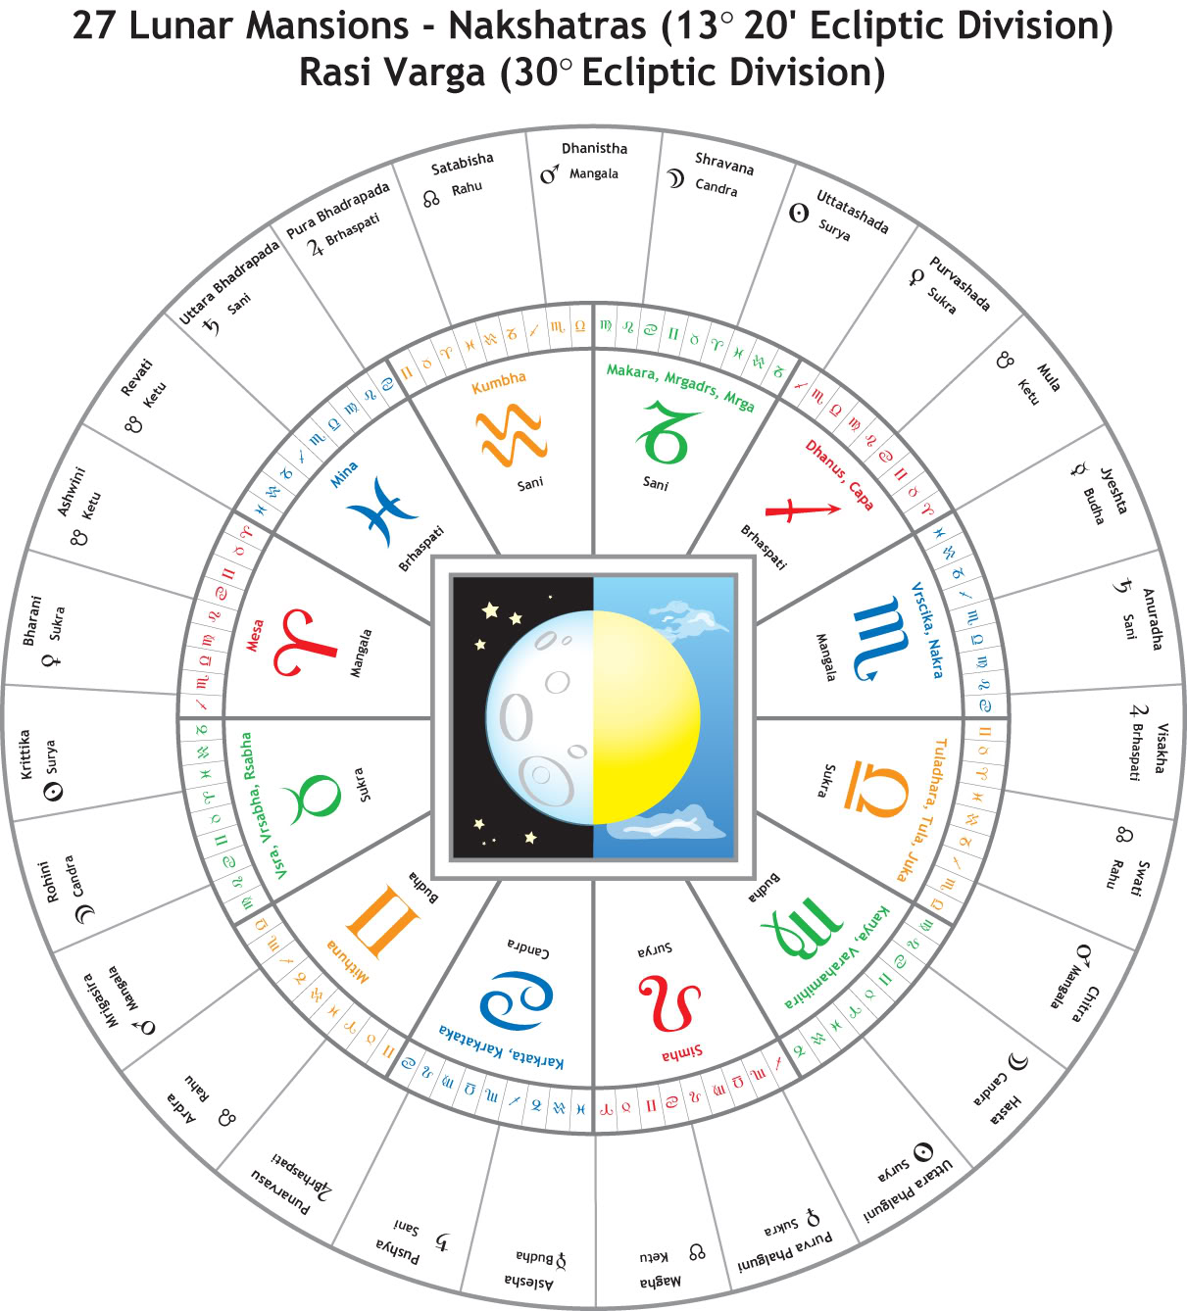
Vedic Zodiac—Stations (27/28)

Slide 28
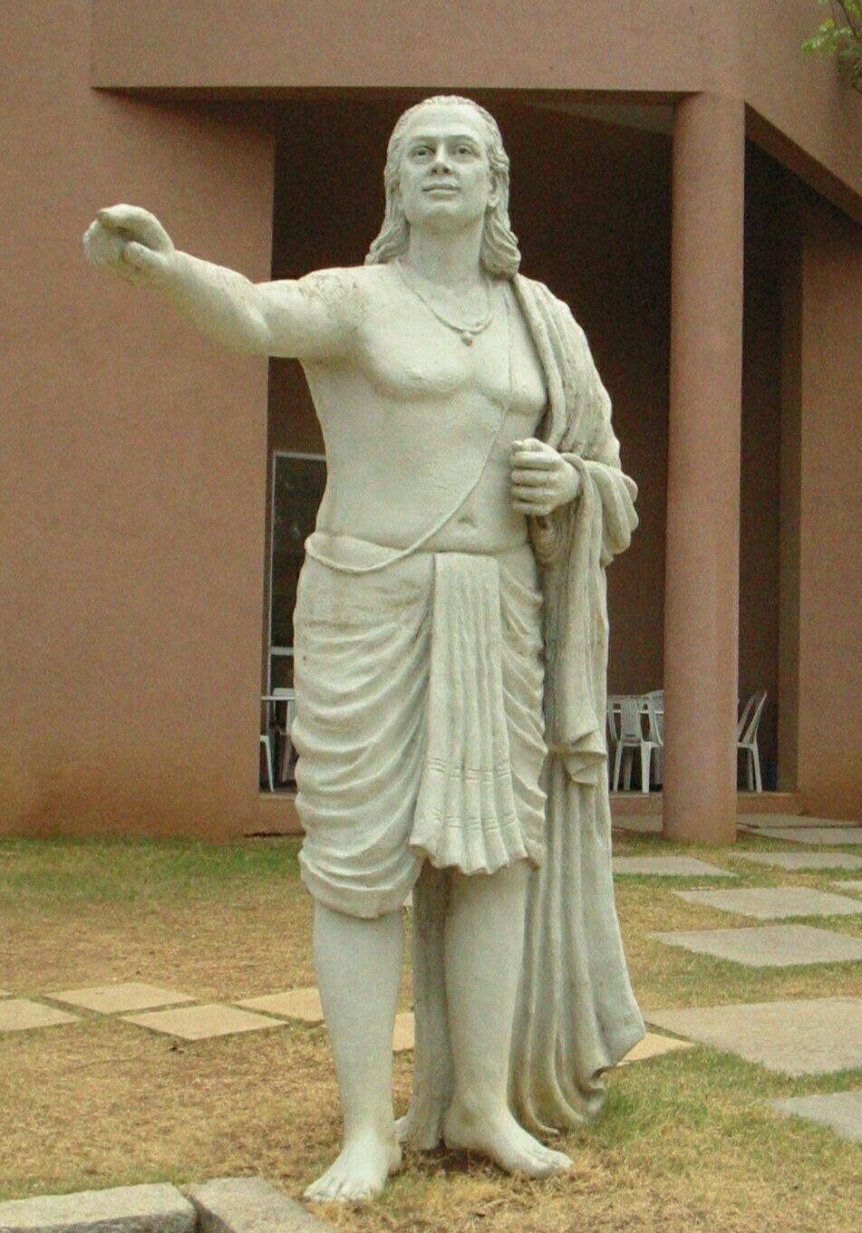
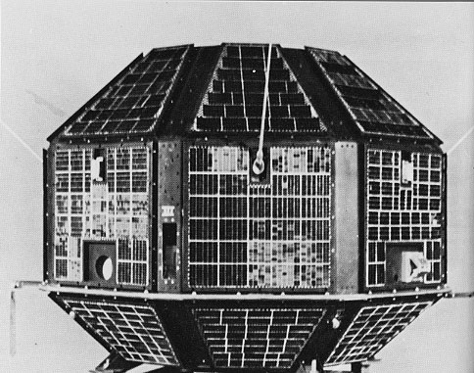
Aryabhata

Slide 29
Two Famous Lines
“Half of the spheres of the Earth, the planets, and the asterisms [stars] is darkened by their shadows, and half, being turned toward the Sun, is light…according to their size…
As a man in a boat going forward sees a stationary object moving backward, just so a [Sri] Lanka man sees the stationary asterisms [stars] moving backward in a straight line.”

Slide 30
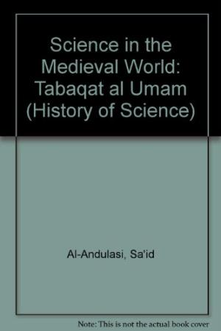
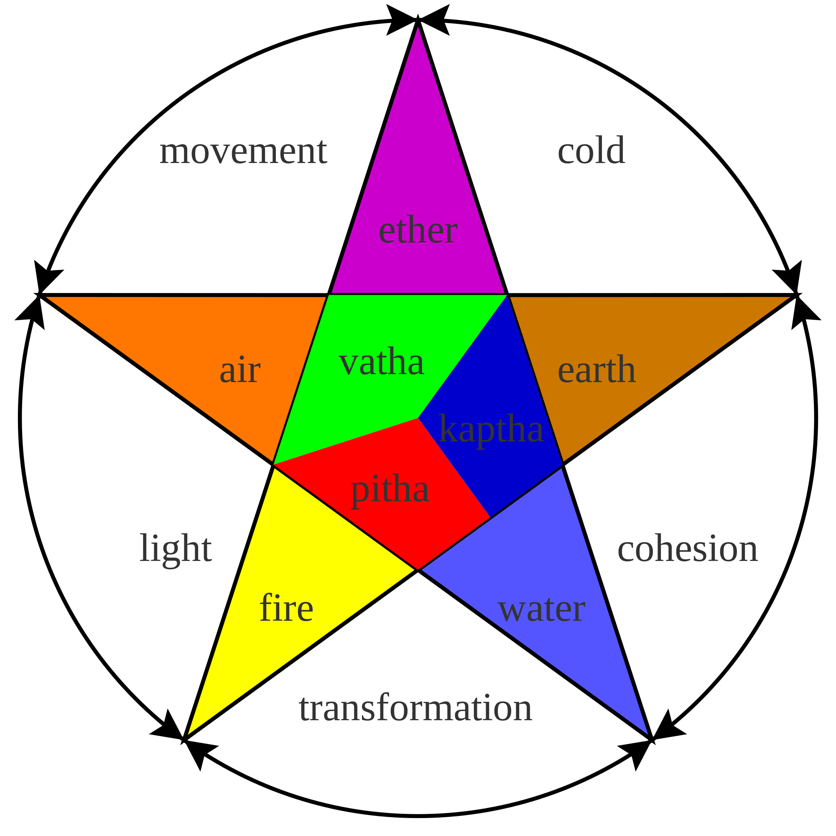
Ayurveda (Ayur-Meaning Life; Veda-Knowledge

Slide 31
Discussing Indian Medicine, Al-Andalusi
“They [Indians] have surpassed all the other peoples in their knowledge of medical science and the strength of various dugs, the characteristics of compounds, and the peculiarities [diversity] of substances.”

Slide 32
Short and General Notes About Indian Medicine
Well respected and till practiced (like TCM still has continual usage)
All things are connected! Have all elements in the cosmos ←→
Health and disease come from the interconnectedness of the mind, body, and the larger world
Interactions between those three above and the world
Whole person emphasis and balance!
Keep harmony
Disease comes from a sophisticated theory of imbalance!
Stress (bad) ← → relaxation-meditation (rebalance)

Slide 33
From the Charaka
“A doctor should drink snake’s poison or hot iron instead of asking for money from a patient. In other words, a doctor must not take money from a patient even for saving his life…This is the reason that a person who wants to become a doctor must make arrangements for his basic needs. He should be able to accumulate medicine and herbs so that he serves society and saves people’s lives.”

